Slide 1
Entelect - Thutong
BY DiGital BlackSmiths

Slide 2
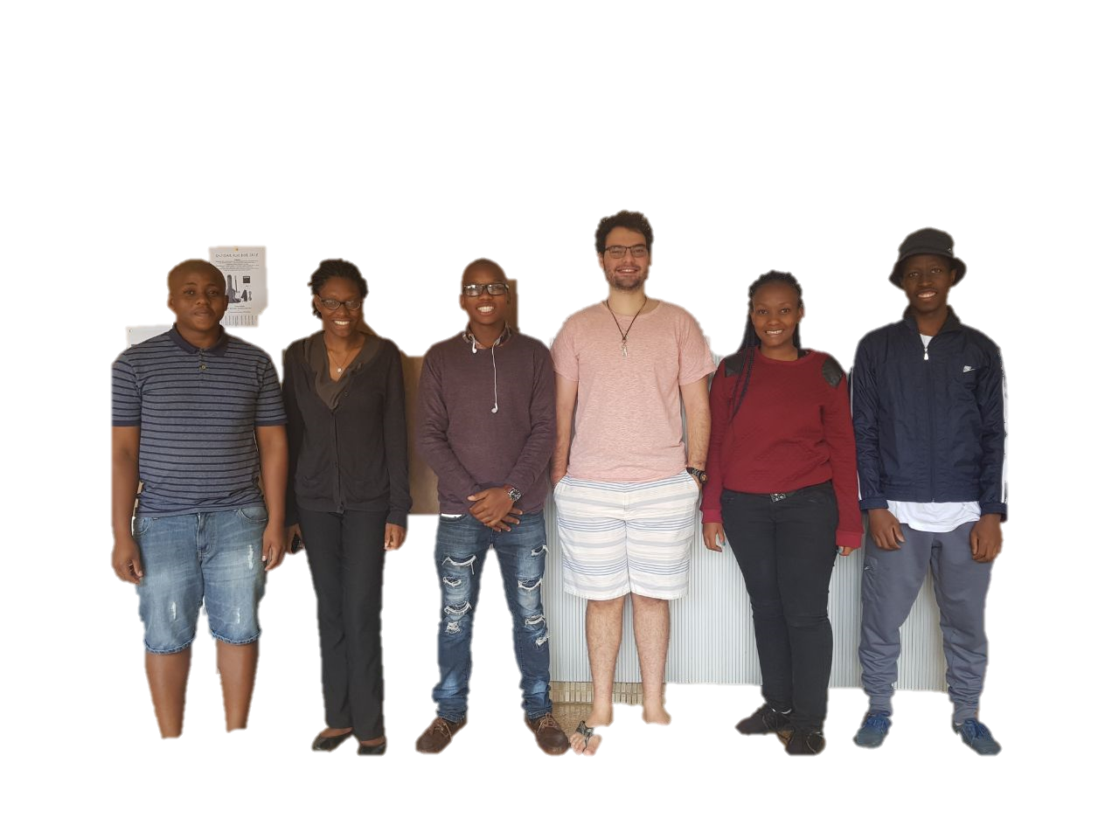
DiGital BlackSmiths
Team Member | Tlou Lebelo | Oluwatosin Botti | Fiwa Lekhuleni | Daniel Rocha | Lebogang Ntlatleng | Lesego Mabe
Role

Slide 3
Thutong Learning Centre
PROJECT DESCRIPTION
Create a mobile friendly, easy to use and easily to maintain learning system for all learners that follow the SA School Curriculum in order to improve learners' subject results in Mathematics and Science and enhance their ICT skills, by providing a free and accessible educational learning platform online.

Slide 4
GiT Structure

Slide 5
Code quality

